Slide 1
Cool Band Names Studio
Notes:
Minimum checklist:
Target audience
Core objective
List of challenges
Unique features and/or mechanics
How the player will control the game

Slide 2
A Garbage Can That Wants To See The World
A stealth game without any combat.
Get through the facility without getting caught.
Is blind, and can only see through the eyes of other devices.
Notes:
A stealth game where you don’t fight; only survive
Accompany an AI through the journey to see the outer world

Slide 3

Plot Overview
Meet G.A.R.B: An AI formed in a research facility that put itself into a garbage can to see the outside world.
GARB will have to stealthily avoid Facility Faculty and Security to escape.
Notes:
Summary: An AI trapped in a research facility wants to escape and see the real world by putting itself into a garbage can < core objective
Picture of GARB
As you get close to your freedom, more challenges that want to shackle you down arise

Slide 4
Narrative Delivery
Throughout the game, major narrative points will be delivered by cutscenes. Smaller points and world building elements will be integrated into the levels themselves
Players will form a bond with GARB as they journey through the levels together. They will initially experience a sense of curiosity, and then a sense of hope as the game progresses and the mood and environment becomes cleaner
Sound and level designs will change throughout the game to add to the narrative.
Notes:
- Feelings: charming, hopeful, curious. Convey that the game has a thoughtful, slow pace. Elevated level of hopefulness as you go up each level, eager to leave the facility. (from target audience slide)
- world building elements: NPC conversations, emails??
- Why should the player care for GARBy?
- How we will let the player know of the story. How is the story told.

Slide 5

Mechanics
Find your ways past your enemies’ sights, WITH their sights.
Navigate the level without the ability to reveal the area by yourself. Use your enemies’ sights to get around.
Throw or place garbage to divert the attention of NPCs.
New enemies will appear as you move through the levels; each have different mechanics.
Controls with mouse and keyboard:
Mouse: aiming garbage projectile and interaction.
Keyboard: WASD movement
http://www.clipshrine.com/sign-CCTV-55438-medium.html
Notes:
-unique mechanic - the constraint of not being able to see for yourself at all will add a new dimension to the mechanics of a traditional stealth game.
-controls - players will use mouse and keyboard
-hackable devices:
Cameras: reveal the play area. Once a camera has been hacked you always see what it sees.
Doors: gives access to a section of the play area
(?)Microphone: allows you to locate NPCs without seeing them (we might have a mi
Elevators: the end of a level and the return point if the player is caught
-All NPCs will all react to thrown trash: Only Janitors actually move to it, Guards and Researchers only look at it
-Fail state for the player:
-If a Janitor see you at all
-If a Reseacher or Guard
Non Player Characters: Guards, Researchers and Janitors.
All NPCs will react to tossed garbage and have a cone of vision
Guards (Blue Hats): Have hackable body cameras. Ignores the PC if they are not moving. Will move to the area of tossed garbage, but will not go to pick it up.
Researchers(White Coats): Same as Guards, but no body camera.
Janitors(Grey Coveralls): No body camera, will move to dropped garbage. Will fail the player if they see the PC.

Slide 6
Gameplay
Gameplay difficulty will gradually increase with every level, as more obstacles will appear in later levels.
Gameplay loop: Hack → Observe → Solve → Execute
[Hacking will involve a small puzzle itself to increase tension.]
Each level starts with the PC exiting an elevator and will have to reach another elevator to progress through the facility.
If the player is caught moving. they are returned to the beginning of the level.
Notes:
Hacking will involve a small puzzle itself to increase tension.

Slide 7

Challenges: Level 1
Tutorial: Garbage Disposal
A short level starting with a cutscene to introduce the premise of the game. Learn the core mechanic and controls by maneuvering the environment with no NPCs.
Notes:
Tutorial here or @ mechanics slide? - intro cut scene, garbage disposal level. No enemy only learning the movement + hacking mechanic

Slide 8

Challenges: Level 2
Storage Area
First NPCs appear: Guards
Cleaner than the Garbage Disposal level, but still dark and dingy. NPC echo this feeling.
Tests the player’s knowledge learned from the tutorial.
Notes:
2: storage room: first enemies appear - guards. Cleaner than garbage disposal, but still dreary.
Combine Level 2 & Level 3 slides?

Slide 9
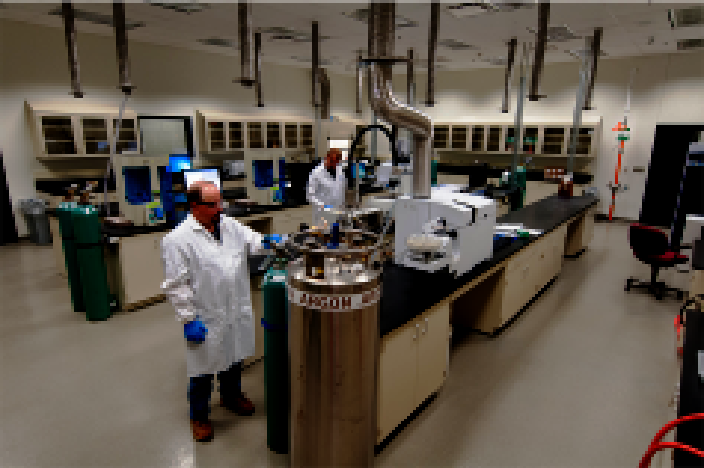
Challenges: Level 3
Research Area
New enemies: Researchers.
Both Researchers and Guards present.
Much cleaner and brighter than the first two levels.
More difficult and intricate path to the elevator
Notes:
Add a visual? Plants office space?

Slide 10

Challenges: Level 4
Final Level: Ground floor
Last obstacles appear: Janitors.
Cleanest area with windows to the outside
Cutscene at the very end of the level as an ending: did you succeed?
Notes:
Add a visual?

Slide 11
Target Audience + Project Development
Targeted ESRB rating of E
For those who enjoy stealth and puzzle games that requires thinking, but still want something with a light-hearted aesthetic.
Will be built in GameMaker: Studio and available for PC.
Single player experience
Notes:
May be moved to the end
-for all ages(?) and gender? Youth-young adult? whoever wants to accompany the journey?
-PC single player
-those who enjoy stealth games, but still want something light-hearted??
Feelings: charming, hopeful, curious. Convey that the game has a thoughtful, slow pace. Elevated level of hopefulness as you go up each level, eager to leave the facility.
-pro

Slide 12
Everything is subject to change
Almost all facet of the game is not safe from disposal if it does not meet our standards, isn’t technically feasible, or if we are restricted by time

Slide 13
People behind [game title]
Writer:
Music and Sound:
Artist
Programmers:

